Slide 1


Notebooks as Functions with papermill.
Using Nteract Libraries @github.com/nteract/

Slide 2


Speaker Details
Matthew Seal
Backend Engineer on the Big Data Platform Orchestration Team @ Netflix

Slide 3



What does a data platform team do?
Data Inputs
Events
Outcomes
Reports
Data Models
...
Machine
Learning
ETL
Data Transport
System Metrics
Aggregation
...
Data Platform Services
Compute Scheduling
Storage
...

Slide 4

Data Platform
Opens Doors
...
not this one

Slide 5





Open Source Projects
Contributed to by

Slide 6

Jupyter Notebooks

Slide 7

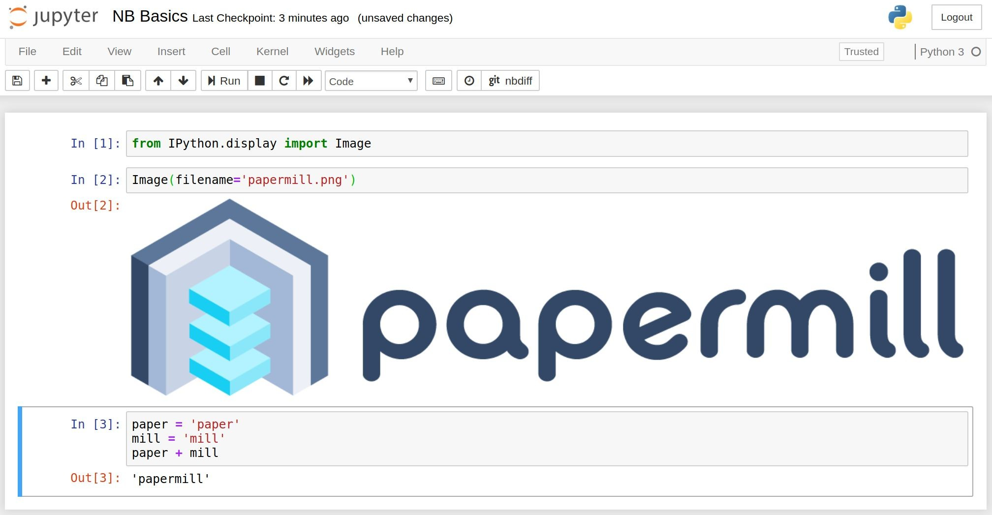

Slide 8
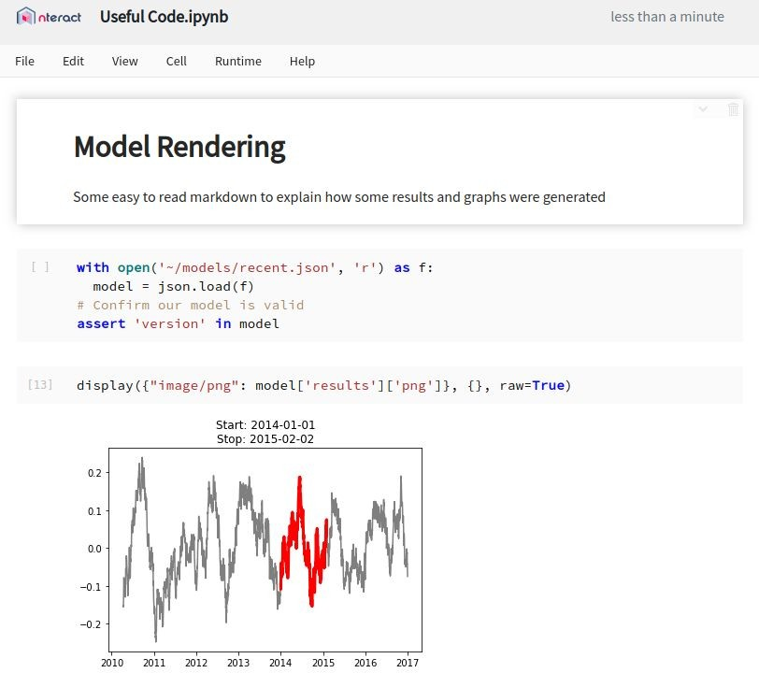
Notebooks.
A rendered REPL combining
Code
Logs
Documentation
Execution Results.
Useful for
Iterative Development
Sharing Results
Integrating Various API Calls

Slide 9
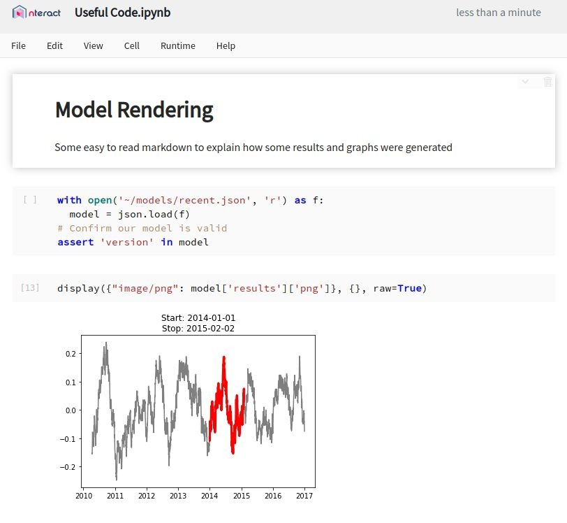

A Breakdown
Status / Save Indicator
Code Cell
Displayed Output

Slide 10
Wins.
Shareable
Easy to Read
Documentation with Code
Outputs as Reports
Familiar Interface
Multi-Language

Slide 11


Notebooks: A Repl Protocol + UIs
Jupyter
UIs
develop
execute code
receive outputs
share
save / load
.ipynb
Jupyter Server
forward requests
Jupyter Kernel
It’s more complex than this in reality

Slide 12
Traditional Use Cases

Slide 13



Exploring and Prototyping.
Notebook
explore
Data Scientist
analyze

Slide 14
The Good.
Notebooks have several attractive attributes that lend themselves to particular development stories:
Quick iteration cycles
Expensive queries once
Recorded outputs
Easy to modify

Slide 15
The Bad.
But they have drawbacks, some of which kept Notebooks from being used in wider development stories:
Lack of history
Difficult to test
Mutable document
Hard to parameterize
Live collaboration

Slide 16

Filling the Gaps

Slide 17
Focus points to extend uses.
Things to preserve: Things to improve:
Results linked to code
Good visuals
Easy to share
Not versioned
Mutable state
Templating

Slide 18

Papermill
An nteract library

Slide 19



A simple library for executing
notebooks.
efs://users/mseal/notebooks
s3://output/mseal/
S3
EFS
parameterize & run
input
Papermill
store
run_1.ipynb
run_2.ipynb
template.ipynb
input notebook
run_3.ipynb run_4.ipynb
output notebooks

Slide 20
Choose an output location.
import papermill as pm
pm.execute_notebook('input_nb.ipynb', 'outputs/20190402_run.ipynb')
…
# Each run can be placed in a unique / sortable path
pprint(files_in_directory('outputs'))
outputs/
...
20190401_run.ipynb 20190402_run.ipynb

Slide 21
Add Parameters
# Pass template parameters to notebook execution
pm.execute_notebook('input_nb.ipynb', 'outputs/20190402_run.ipynb',
{'region': 'ca', 'devices': ['phone', 'tablet']})
…
# Default values for our potential input parameters
region = 'us' devices = ['pc']
date_since = datetime.now() - timedelta(days=30)
# Parameters
region = 'ca'
devices = ['phone', 'tablet']

Slide 22
Also Available as a CLI
# Same example as last slide
pm.execute_notebook('input_nb.ipynb', 'outputs/20190402_run.ipynb',
{'region': 'ca', 'devices': ['phone', 'tablet']})
…
# Bash version of that input
papermill input_nb.ipynb outputs/20190402_run.ipynb -p region ca -y '{"devices": ["phone", "tablet"]}'

Slide 23



Notebooks: Programmatically
read
write
Jupyter
Papermill
UIs
develop
develop
execute code
receive outputs
execute code
receive outputs
share
share
save / load
.ipynb
Jupyter Server
forward requests
Jupyter Kernel
forward requests
Kernel Manager

Slide 24




How it works a bit more.
Notebook
Notebook Sinks
Reads from a source
Injects parameters
Launches a runtime manager + kernel
Sends / Receives messages
Outputs to a destination
Sources
input
Papermill
store
database
database
source notebook
output notebook
execute kernel
cells messages
file
file
Runtime Manager
service
service
Parameters
stream input/output messages
p1 = 1
p2 = true
parameter values
p3 = []
Runtime Process

Slide 25
Parallelizing over Parameters.
Notebook Job #1
a=1
a=4
a=2
a=3
Notebook Job #2
Notebook Job #3
Notebook Job #4
Notebook Job #5

Slide 26

New Users &

Slide 27


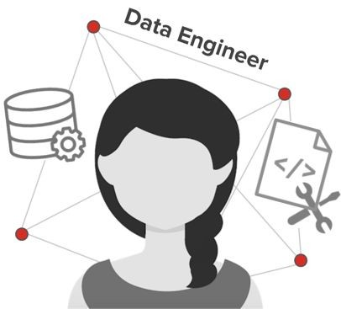

Expanded Use Cases
￼￼
Scheduler / Platform
Papermill
Developed Notebooks
Scheduled Outcomes

Slide 28
Support for Cloud Targets
# S3
pm.execute_notebook( 's3://input/template/key/prefix/input_nb.ipynb', 's3://output/runs/20190402_run.ipynb')
# Azure
pm.execute_notebook( 'adl://input/template/key/prefix/input_nb.ipynb', 'abs://output/blobs/20190402_run.ipynb')
# GCS
pm.execute_notebook( 'gs://input/template/key/prefix/input_nb.ipynb', 'gs://output/cloud/20190402_run.ipynb')
# Extensible to any scheme

Slide 29

Plug n’ Play Architecture
New Plugin PRs Welcome

Slide 30
Entire Library is Component Based
# To add SFTP support you’d add this class
class SFTPHandler():
def read(self, file_path):
...
def write(self, file_contents, file_path):
...
# Then add an entry_point for the handler from setuptools import setup, find_packages setup(
# all the usual setup arguments ...
entry_points={'papermill.io': ['sftp://=papermill_sftp:SFTPHandler']}
)
# Use the new prefix to read/write from that location
pm.execute_notebook('sftp://my_ftp_server.co.uk/input.ipynb',
'sftp://my_ftp_server.co.uk/output.ipynb')

Slide 31
Diagnosing with

Slide 32
Failed Notebooks
A better way to review outcomes

Slide 33

Debugging failed jobs.
Notebook Job #1
Failed Notebook Job #3
Notebook Job #2
Notebook Job #4
Notebook Job #5

Slide 34
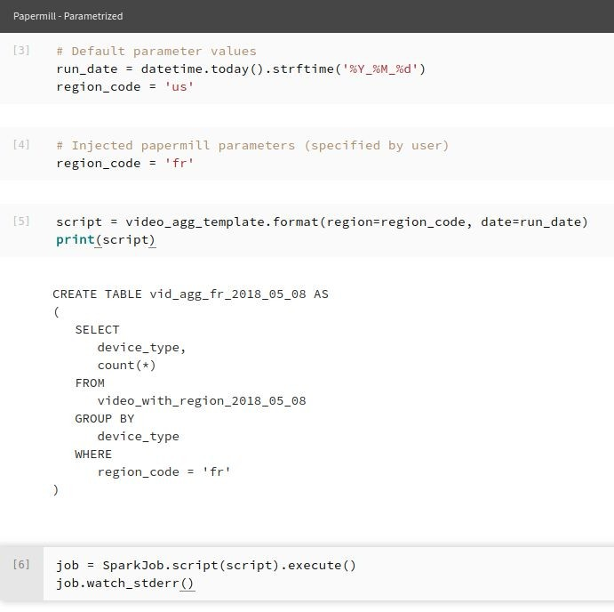

Failed outputs are useful.
Output notebooks are the place to look for failures. They have:
Stack traces
Re-runnable code
Execution logs
Same interface as input

Slide 35
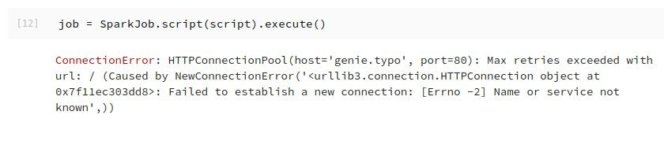
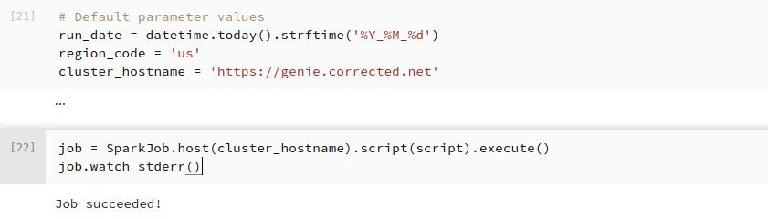
Find the issue.
Test the fix.
Update the notebook.

Slide 36
Changes to the notebook experience.
Adds notebook isolation
Immutable inputs
Immutable outputs
Parameterization of notebook runs
Configurable sourcing / sinking
and gives better control of notebook flows via library calls.

Slide 37
How notebooks

Slide 38
Notebooks Are Not Libraries
Try to not treat them like a library

Slide 39
Notebooks are good integration tools.
Notebooks are good at connecting pieces of technology and building a result or taking an action with that technology.
They’re unreliable to reuse when complex and when they have a high branching factor.

Slide 40
Some development guidelines.
Keep a low branching factor
Short and simple is better
Keep to one primary outcome
(Try to) Leave library functions in libraries
Move complexity to libraries

Slide 41
Tests via papermill
Integration testing is easy now

Slide 42
Controlling Integration Tests
# Linear notebooks with dummy parameters can test integrations
pm.execute_notebook('s3://commuter/templates/spark.ipynb', 's3://commuter/tests/runs/{run_id}/spark_output.ipynb'.format(
run_id=run_date),
{'region': 'luna', 'run_date': run_date, 'debug': True})
…
# Parameters
region = 'luna' run_date = '20180402' debug = True
spark.sql('''
insert into {out_table} select * from click_events where date = '{run_date}' and envt_region = '{region}'
'''.format(run_date=run_date, enc_region=region, out_table='test/reg_test if debug else 'prod/reg_' + region))

Slide 43

Other Ecosystem

Slide 44
Host of libraries.
To name a few:
nbconvert
commuter
nbformat
bookstore
scrapbook
- ...
See jupyter and nteract githubs to find many others

Slide 45
Scrapbook
Save outcomes inside your notebook

Slide 46

Adds return values to notebooks
# Inside your notebook you can save data by calling the glue function
import scrapbook as sb
sb.glue('model_results', model, encoder='json')
…
# Then later you can read the results of that notebook by “scrap” name
model = sb.read_notebook('s3://bucket/run_71.ipynb').scraps['model_results']
…
# You can even save displays and recall them just like other data outcomes
sb.glue('performance_graph', scrapbook_logo_png, display=True)

Slide 47
Commuter
A read-only interface for notebooks

Slide 48
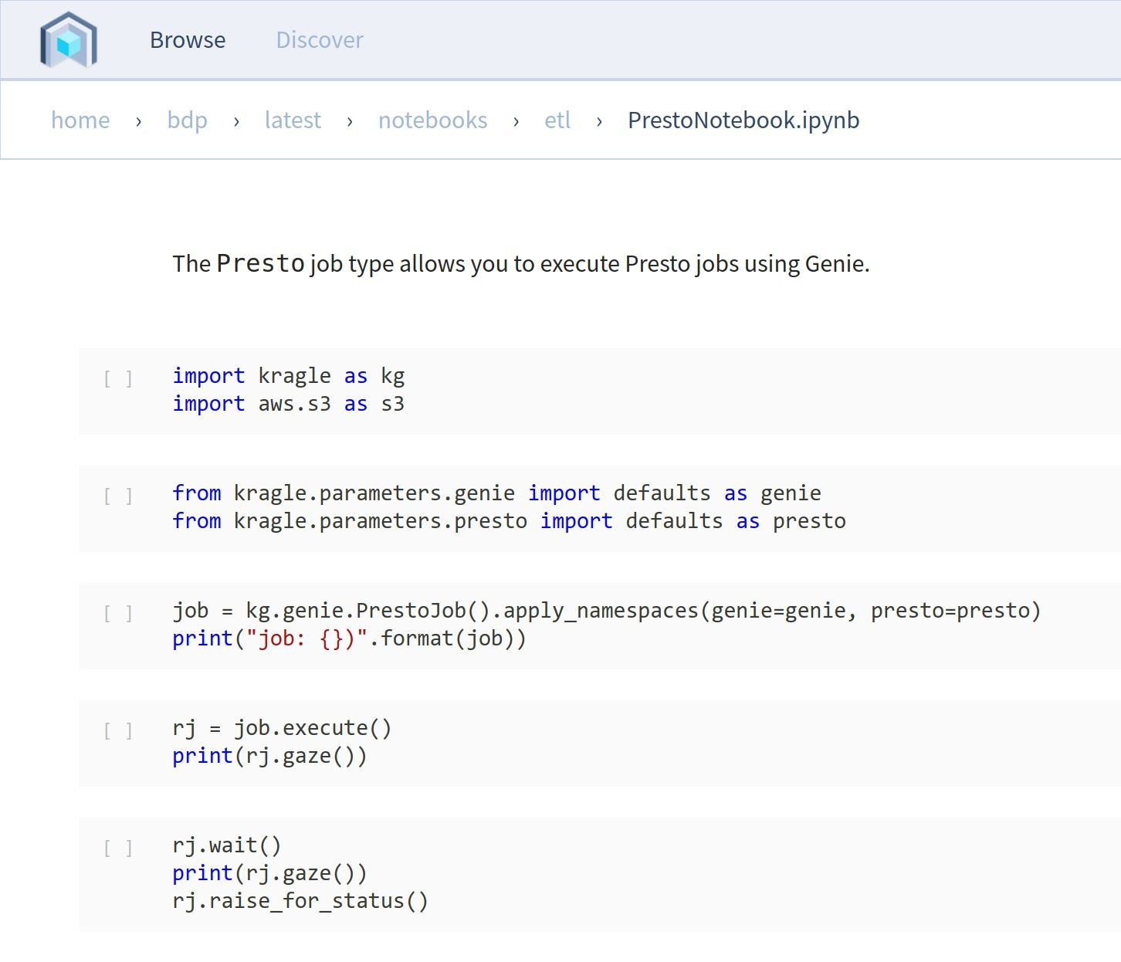
Commuter Read-Only Interface
No kernel / resources required

Slide 49

Notebooks

Slide 50

A strategic bet!
We see notebooks becoming a common interface for many of our users.
We’ve invested in notebook infrastructure for developing shareable analysis resulting in many thousands of user notebooks.
And we’ve changed over 10,000 jobs which produce upwards of 150,000 queries a day to run inside notebooks.

Slide 51

We hope you enjoyed the session

Slide 52

Questions?
https://slack.nteract.io/ https://discourse.jupyter.org/

